Slide 1

Participate
Notes:
Participate in the polls
1 poll already active to get an idea of roles in the audience

Slide 2
ROAST MY
DESIGN DECISIONS
Real-life trade-offs, success and failure
Steven Hillaert – solution architect

Slide 3

Poll
Do you trust my database?
The bank – poll 1

Slide 4
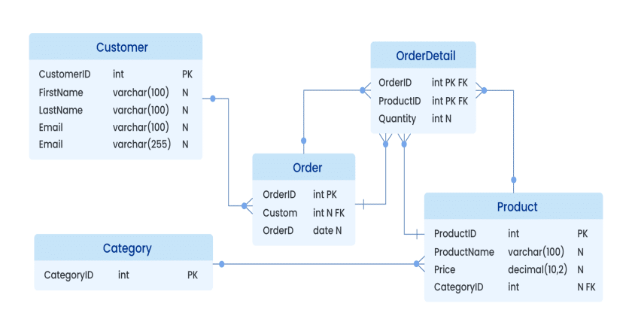
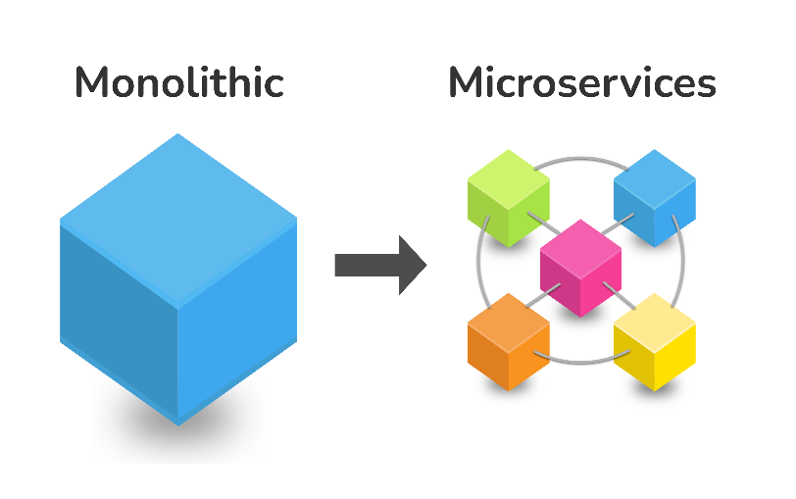
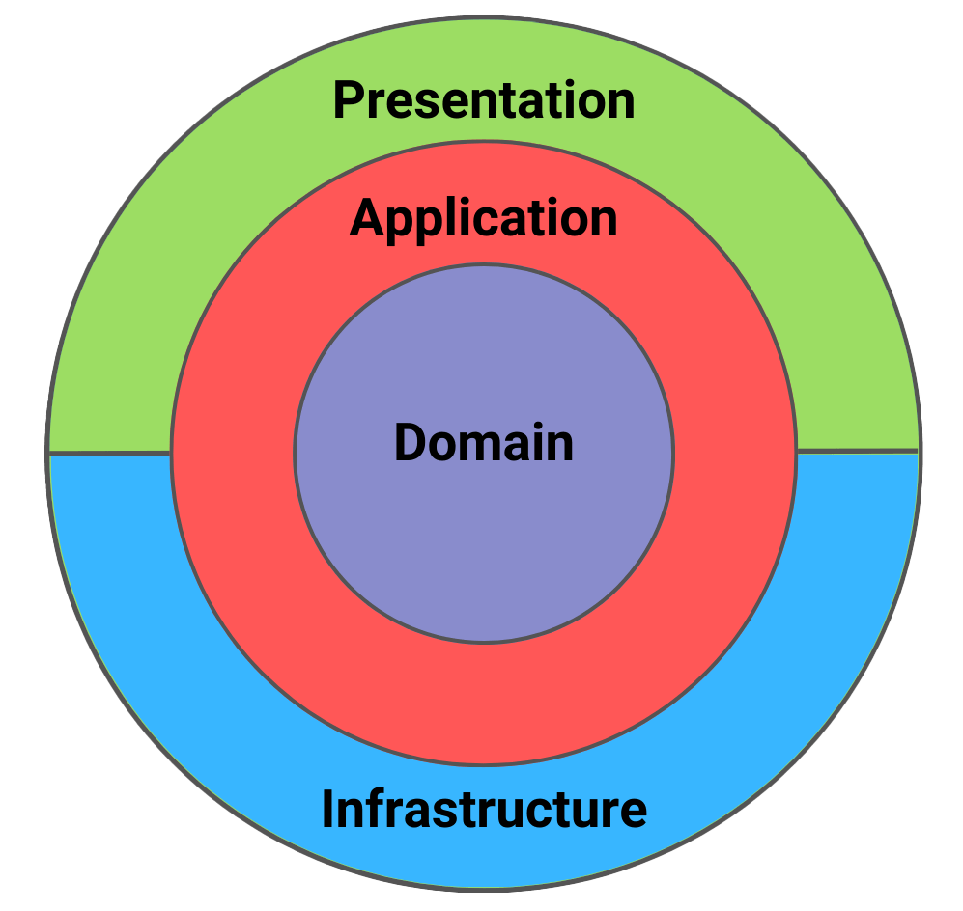
Continuum of decisions
CODE
class/component
DESIGN
application/process
ARCHITECTURE
system
List vs Set vs Queue
ORM
SOLID
CQRS
Easy to change
High impact
Notes:
Functionality ←→ behaviour

Slide 5

Don’t follow my decision blindly
These decisions were made by balancing tradeoffs in a specific context:
Functional
Non-functional
Technical
Strategic
Notes:
DISCLAIMER
Functional impact (what problem do we need to solve)
Non-functional impact (how will it behave)
Technical impact (how to implement the solutions)
Strategic impact (is it aligned with vision and strategy)

Slide 6

Use-case 1 – the bank
System to calculate commissions
Account holders
Accounts
Transactions
Documents
Agents
This impacts someone’s income!
Notes:
Short description of entities
How calculation works

Slide 7

The bank
I designed a relational database without foreign keys.

Slide 8
Poll
Do you trust my database?
The bank – poll 1

Slide 9
The bank – project constraints
Built as consulting service
We deliver the application
We only do 3rd level support
Fixed time and budget
They needed to validate that the latest data is in the commission system (timestamps)

Slide 10
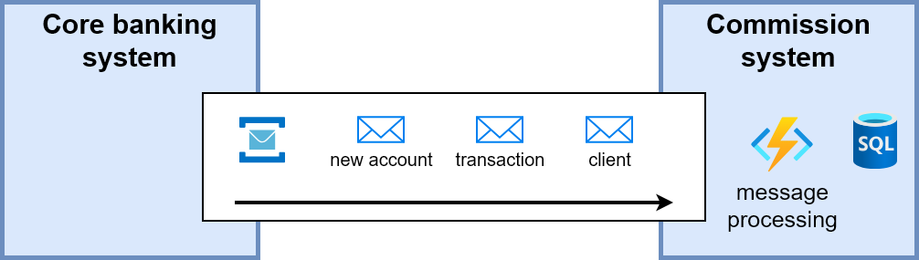
The bank – system
My team
Integration team
Notes:
High level overview how account information arrives.
The application is more than just this:
- mgmt. screens
- calculation
- invoicing
- approval flow

Slide 11
The bank – standard challenges ⚠️
Standard challenges when using message brokers
At-least-once delivery
Out-of-order processing
Poison messages / queues
Monitoring
Inbox pattern
Idempotency
Retries
Built in Azure Service Bus 💶
Tooling (NServiceBus) or custom 💶
Advice: idempotent messaging will save you from a lot of grief

Slide 12
The bank – integration challenges ⚠️
Multiple messages for the same event
  2 create messages, identical data, different timestamp
Different types of messages for the same event (but not always)
  1 update and 1 create message, different timestamp, any order
Out-of-order publishing (very common)
  Updates or deletes before creates
  Transactions before accounts (in general: child entities before parents)
Notes:
All discovered during integration testing (there could be more)
We had no control over these events/messages
Other team couldn’t guarantee “normal” / chronological messages
ASK: how would you solve the out-of-order publishing?

Slide 13
The bank – integration solutions 💡(with FK)
Multiple messages for the same event (2 creates)
  Idempotency, keep the one with most recent timestamp
Different types of messages for the same event (update + create)
  Treat both as upsert, keep the one with most recent timestamp
Out-of-order publishing
  Updates before create ➔ Treat both as upsert, keep the one with most recent timestamp
  Child entities before parents ➔ Retry until parent exists
Notes:
All discovered during integration testing (there could be more)
We had no control over these events/messages
Other team couldn’t guarantee “normal” / chronological messages
ASK: how would you solve the out-of-order publishing?

Slide 14
The bank – current status
Still using foreign keys
✔️ Fixed standard messaging challenges with idempotency
✔️ Fixed quirky messages from producer with upsert & idempotency
✔️ Avoided extra tooling/complexity
✔️ Avoided extra costs
❌ Child entity messages before parent can be solved with retries
  Requires monitoring, retries can still end up in poison queues, and verification with source system is difficult

Slide 15
The bank – why do we use FK’s?
FK’s enforce referential integrity

Slide 16
The bank – why that breaks the system
Can’t create child entities before parents
Can’t create transaction before account

Slide 17
The bank – do we need it?
Do we need referential integrity?
(for this project)

Slide 18
The bank – do we need it?
Not really!
We’re not owner of that data
Calculation behaves correct when parent entities would be missing
Eventually consistent
Messages can be processed as they come, no retries needed
Monitoring inconsistencies is easier done from a database

Slide 19
The bank – socio-technical impact
Integration with source system isn’t reliable.
Integration team and my team are external from different suppliers.
The original teams won’t be there forever.
Support will be given by people who didn’t develop the system.
The integration shouldn’t create friction for the customer.
Notes:
Let’s take a step back.
We’ve mainly talked about the technical part.
But there’s more.
Friction here means that unexpected messages or ordering shouldn’t break the system or cause a burden on the customer.

Slide 20
Poll
You like my no-FK database now?
The bank – poll 3

Slide 21
The bank – core lessons
Take a step back and look at the bigger picture
Dare to challenge the “defaults”
Architecture is not about technical purity

Slide 22

Use case 2 – the inspection
Goal:
Standardize decision-making concerning damages (repair, insurance, invoicing…)
Users:
Professionals, fleet managers, drivers
Solution:
Decision tree with questions
(per customer, damage,…)

Slide 23
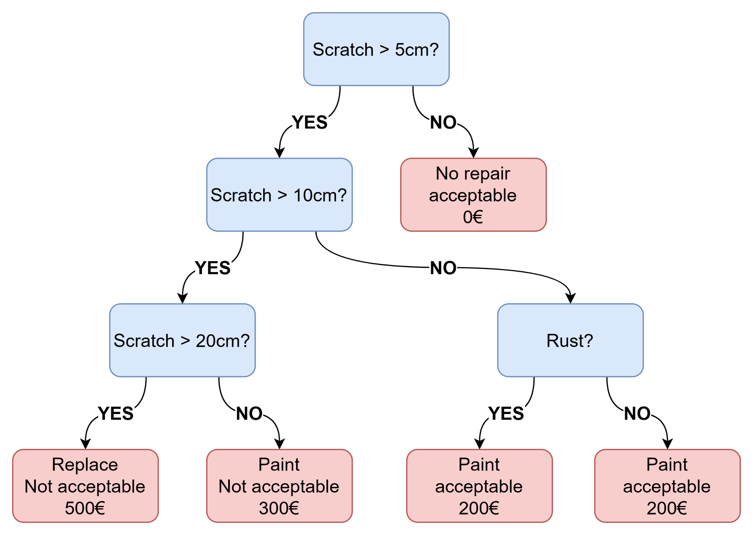
The inspection - example

Slide 24
The inspection – the simplest solution
A tree structure where every node is a plain text yes/no question.
Show the text (question) to the user
User answers yes or no
Show the next question
Until you reach the end node
Workload: +/- 2 weeks

Slide 25

That’s not what I did!
Notes:
This is about how far do we go in our engineering. Under engineering vs over engineering.

Slide 26
The inspection – the not so simple solution
No dumb text-based questions
Intelligent properties & comparators & type safe
Builder & factory patterns
Visitor pattern (traverse the tree in different ways)
Supporting designer in the UI for configuration
Multilingual
Workload: +/- 10 weeks

Slide 27
Poll
Do you trust my overengineering?
The inspection – poll 1

Slide 28
The inspection – a little philosophy
As an architect or tech lead, you’re able to see the greater picture.
You’re involved in more projects and stakeholders at strategic level.
It’s not about predicting the future but the vision and strategy.
Will your decisions support or hinder it?

Slide 29
The inspection – what drove me
Changing landscape of users
Data is key, pure text doesn’t create useful data
Plain text questions don’t scale very well
Decisions need “metadata”, everything needs to be smart
AI/machine learning was being explored
Notes:
- users: professional inspectors don’t want to answer 100 questions

Slide 30
The inspection – my decision
These things drove me to engineer it properly and completely, from the first version.
Too many future paths would need this. Even outside the inspection scope, as basis for a future rule engine.
We were agile in the capabilities offered but not in the core engineering.
Agile is not about creating the fastest and simplest solution!

Slide 31
Poll
You trust my overengineering now?
The inspection – poll 2

Slide 32

The inspection – a few weeks later
“We would like to have the actual values”
“Would this be compatible with AI?”
Starting with the simplest solution can be a risk for the future. (under-engineering)
We’re conditioned to build on what we have.
Notes:
Quickly explain how this was easy to implement.

Slide 33

Use case 3 – the microservices
Small development team
1 monolithic system
Supporting the core business
Everything on-premise
Growing team (x4)
More customers and users
Moving to the cloud
European projects
Expanding beyond the core business
Cohesion between the new opportunities

Slide 34
The microservices – why?
Scalability must increase to support the load
Reuse must increase for shared data and services
Integration must increase to create synergy
New applications need more autonomy
Growing teams need more focus
Avoid single huge deployments
We would do it gradually, we had a plan
Notes:
Explain gradually: by using strangler fig pattern.

Slide 35
Poll
Were microservices the right choice?
The microservices – poll 1

Slide 36
The microservices – the struggle
Started with foundation services
Built core business services on top
Still using a single database
Services started to communicate between each other (a lot)
Dependencies got stronger
Problems were fixed as isolated cases (distributed transactions)
Teams were busy, no governance
Notes:
This was some time ago, I’ve learned better ways to implement microservices.

Slide 37
Poll
Are they still the best choice?
The microservices – poll 2

Slide 38
The microservices – core lessons
Choosing microservices was a good choice
The implementation failed
Boundaries & ownership are the real challenges
Local optimizations can destroy global coherence
  Get it working
  Architecture drift
Reuse is overrated
Notes:
Eventually we did improve the implementation.

Slide 39
The goal of software design and architecture?
We write software to solve today’s problems.
But we must design and architect solutions to continue delivering value in an uncertain, constantly changing future.
Don’t just look at upsides of a design or architecture.
Can you also live with the downsides?

Slide 40
Questions and Feedback

